Slide 1

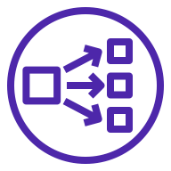


Tracking Service
Tracking Service
Application Load Balancer
Tracking Service
Tracking Service

